Slide 1


redesign
WEBSITE

Slide 2
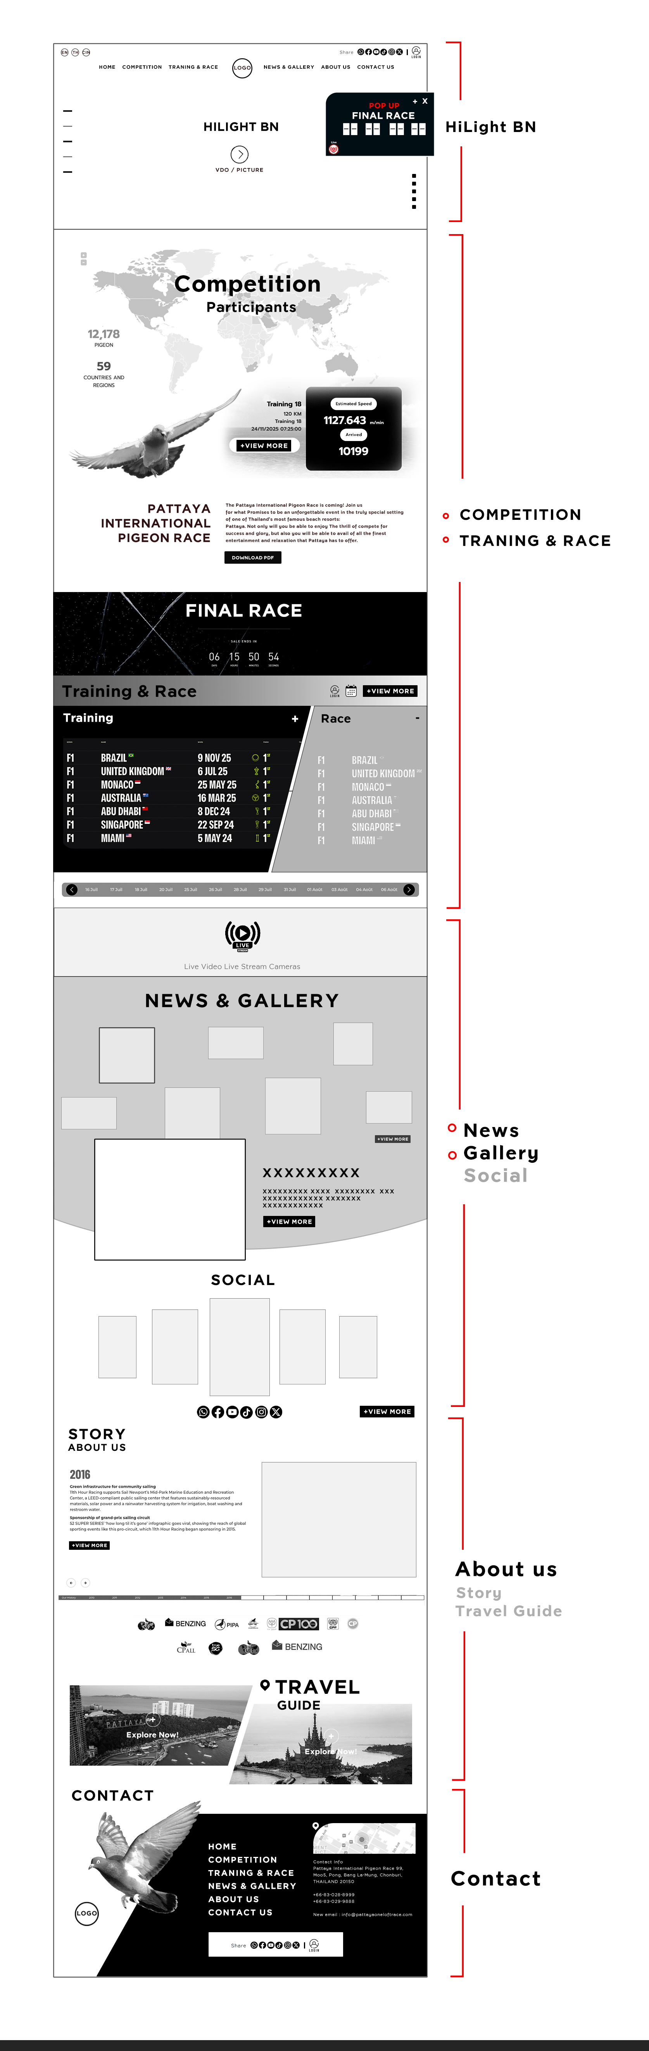

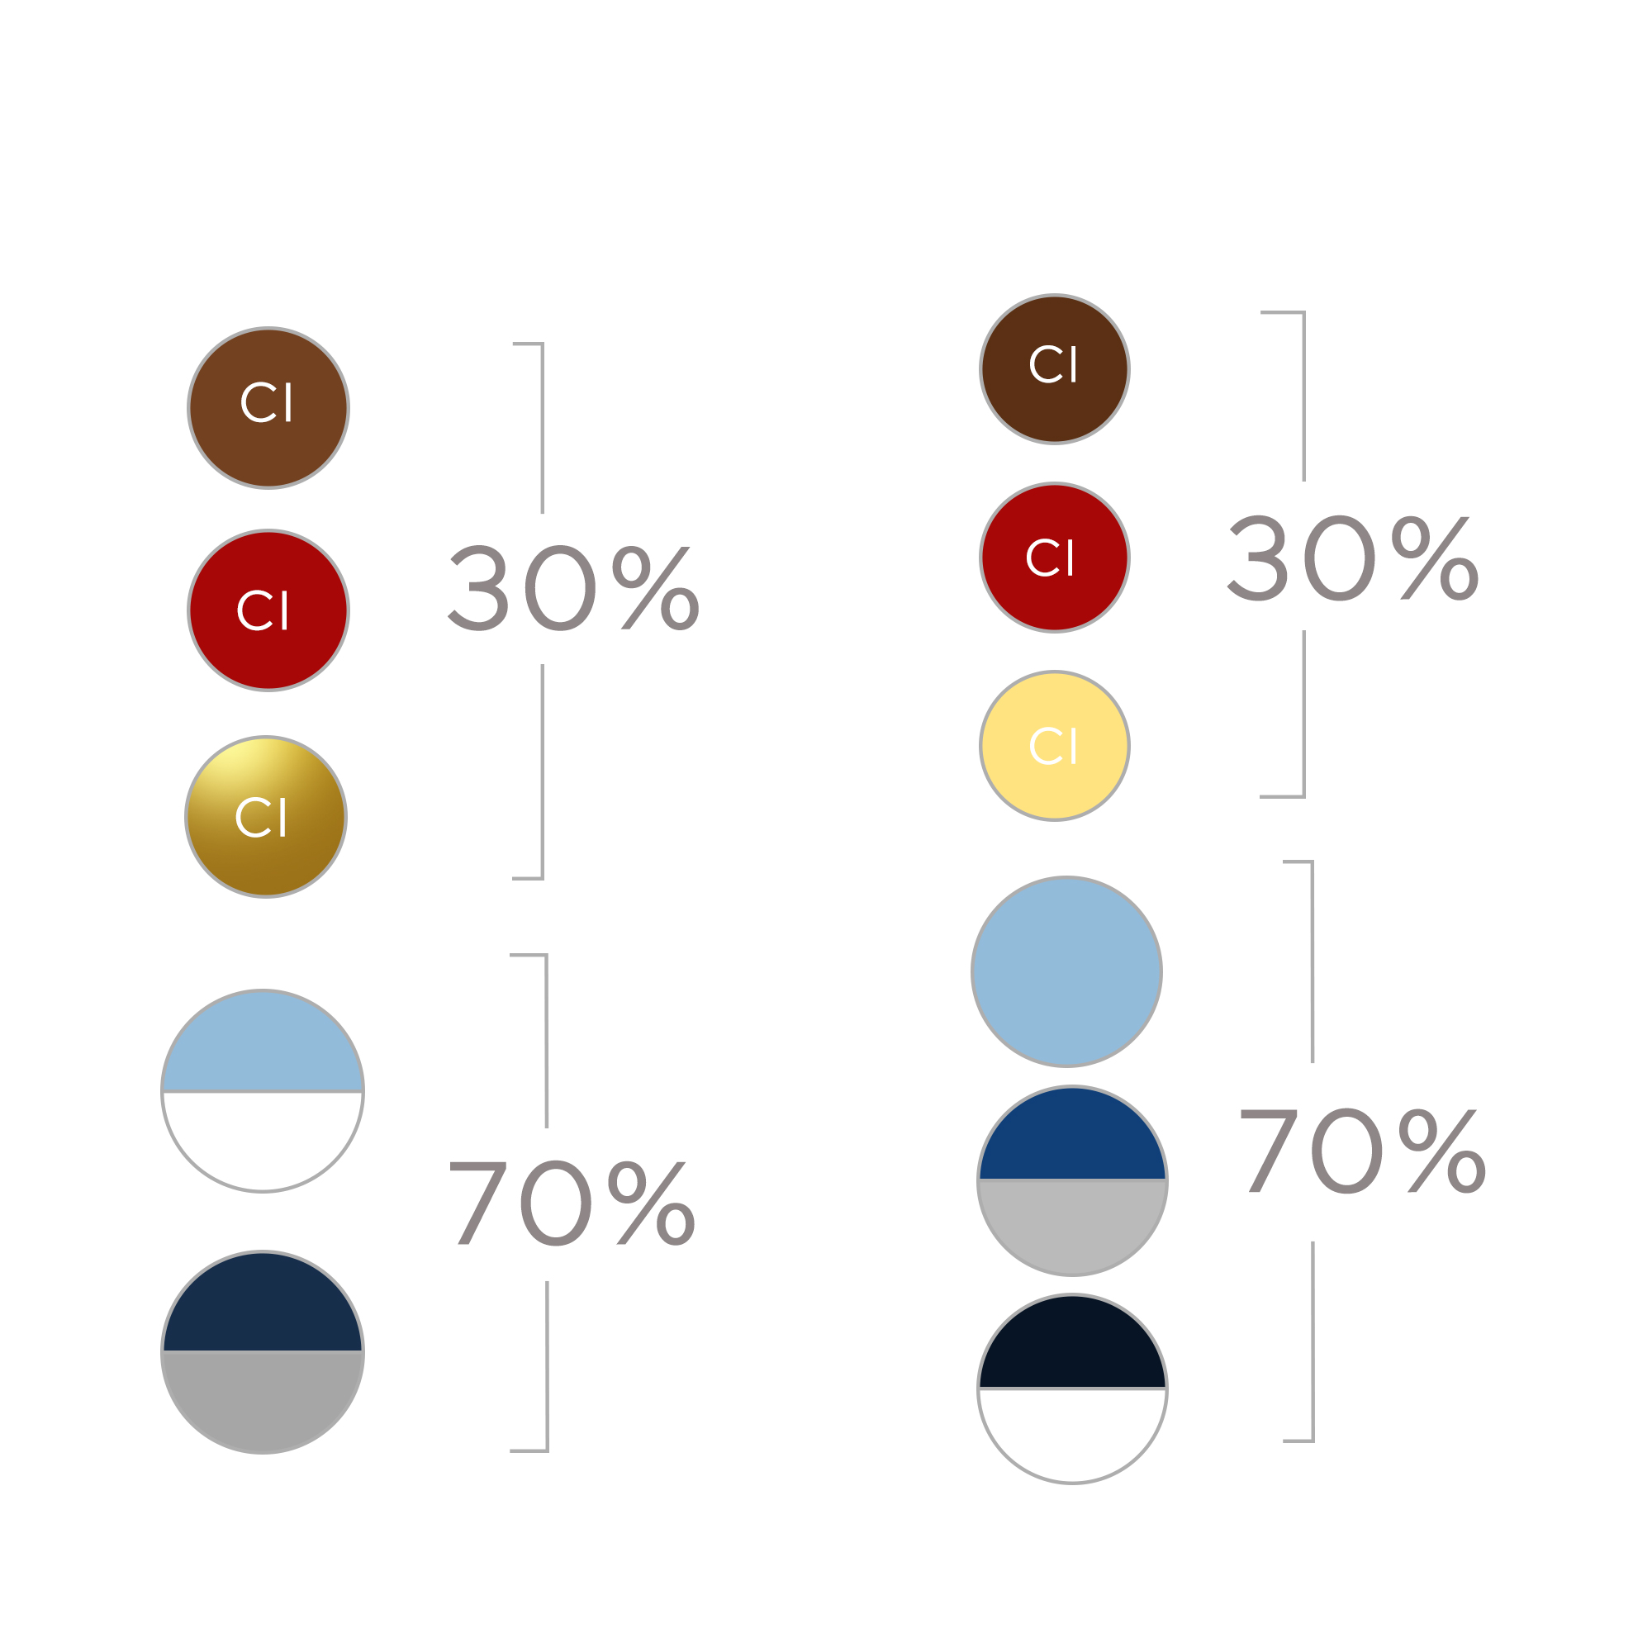
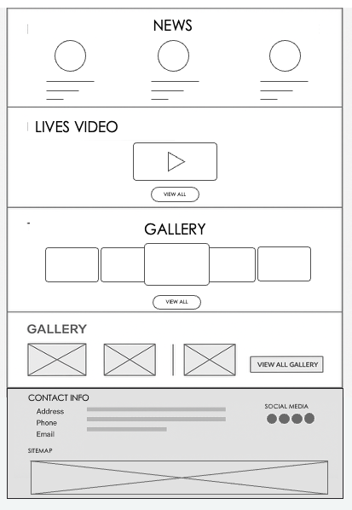
OPTION
OPTION
CUSTOMER
IDEA
HILIGHT BN
WIFRAME
COMPETTITION
Hard
Simple
TRACKS
&RACE
Limited target audience
Easy access
NEWS
&GALLERY
CONTACT US

Slide 3
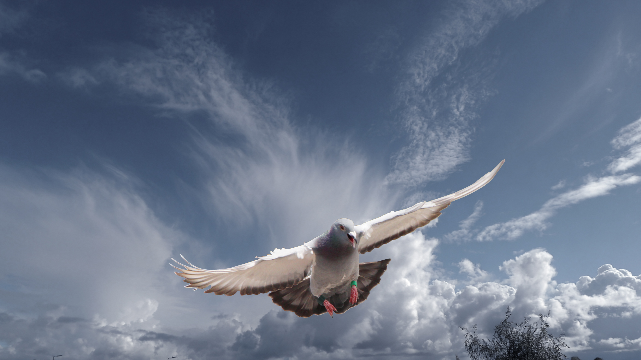
1
OPTION
customer

Slide 4

WIFRAME
CUSTOMER
LINK

Slide 5

Ref
OVER ALL
CUSTOMER
LINK

Slide 6

Ref
OVER ALL
CUSTOMER
LINK

Slide 7


Ref
OVER ALL
CUSTOMER
Style, interface
LINK

Slide 8

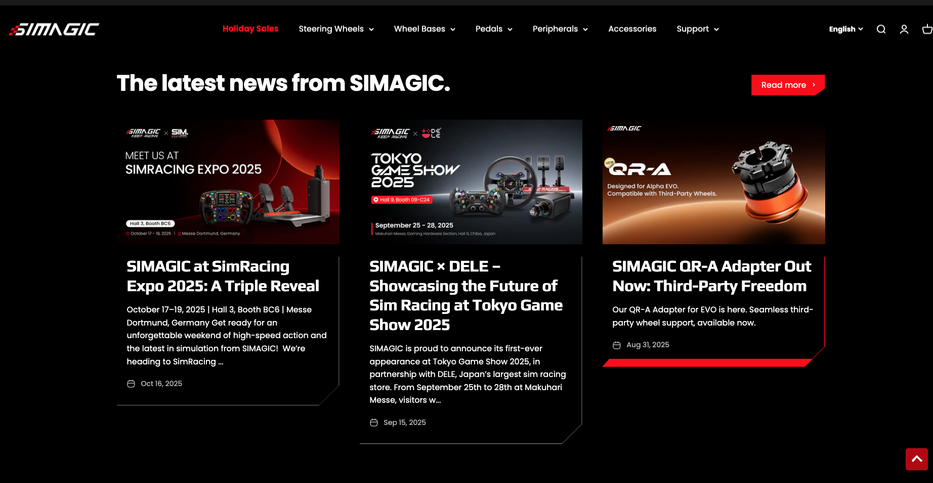
Ref
OVER ALL
CUSTOMER
Style, interesting playfulness
LINK

Slide 9

OPTION
IDEA

Slide 10
WIFRAME
IDEA
Easy access
Simple

Slide 11

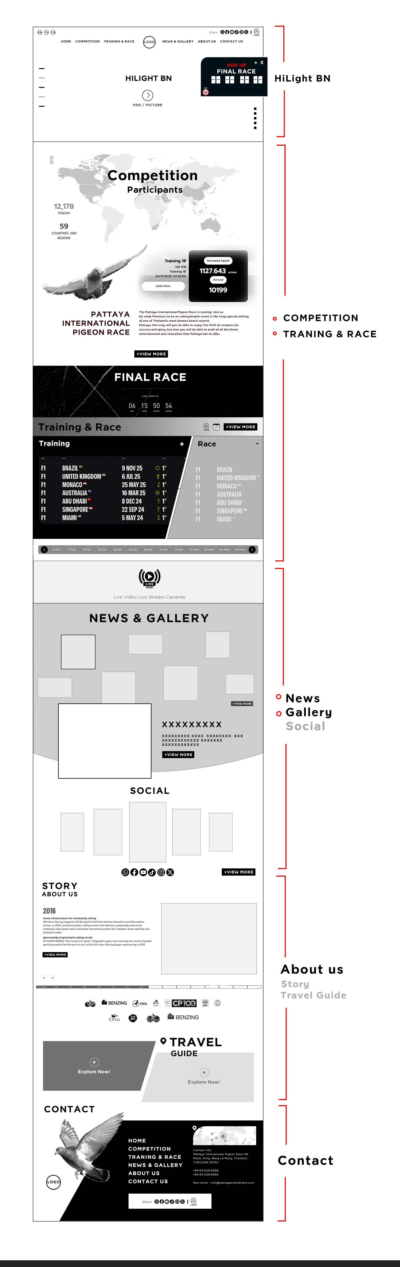

Slide 16

2
OPTION
IDEA

Slide 17

Ref
OVER ALL
CUSTOMER
LINK

Slide 18
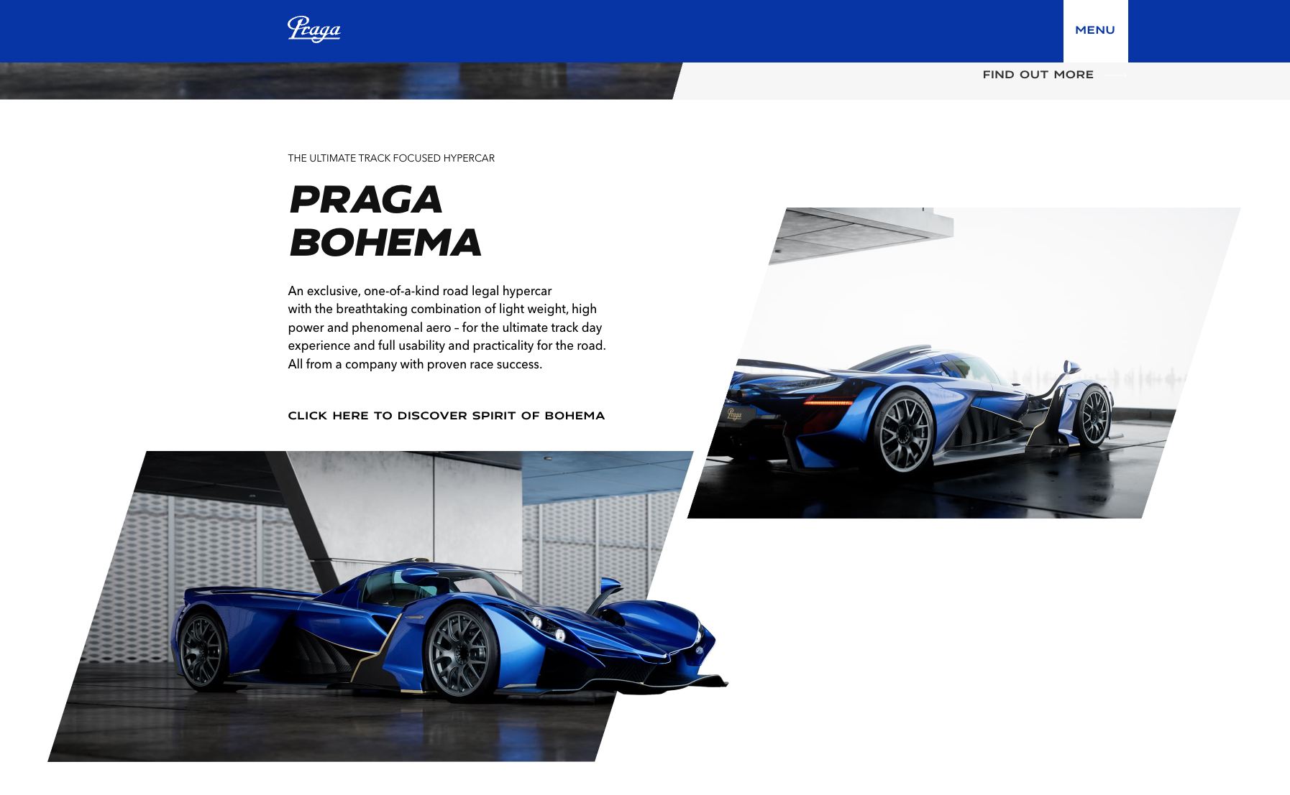
Ref
OVER ALL
CUSTOMER
LINK

Slide 19
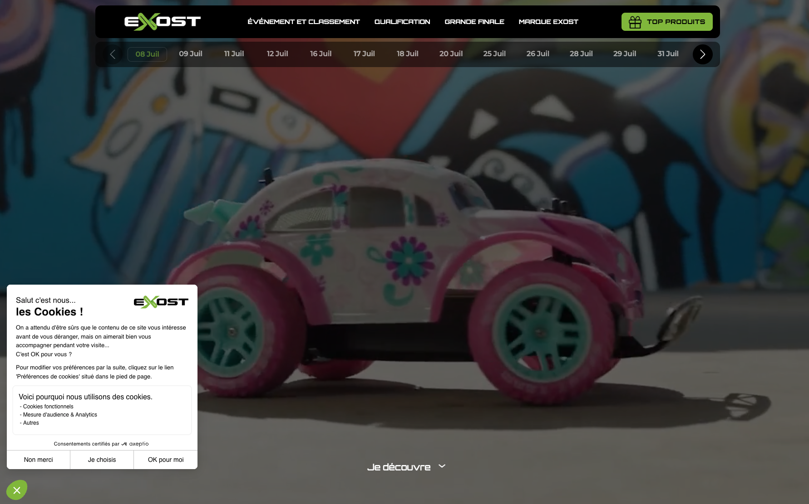
Ref
OVER ALL
CUSTOMER
LINK

Slide 20
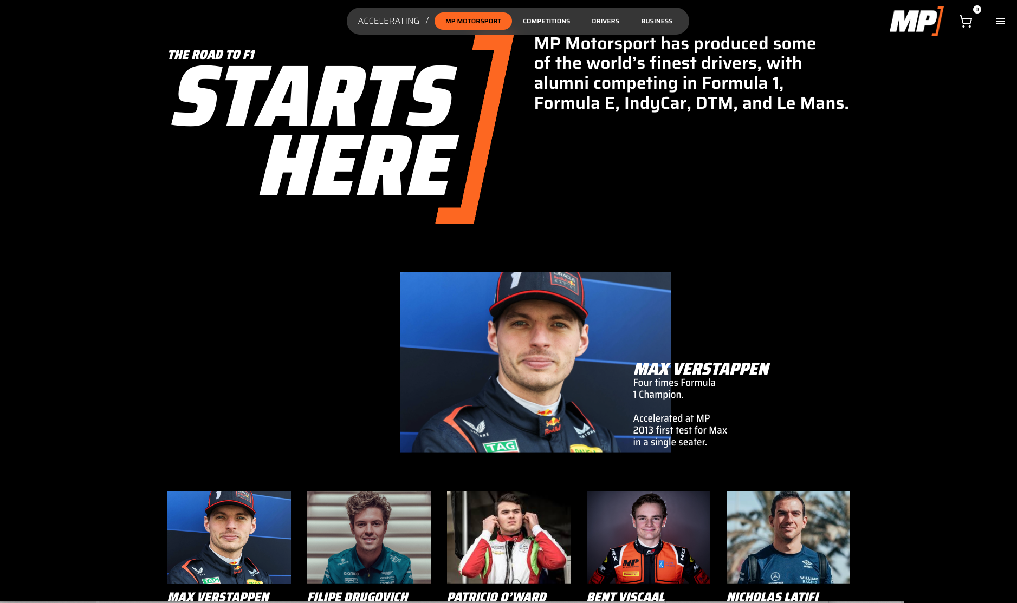

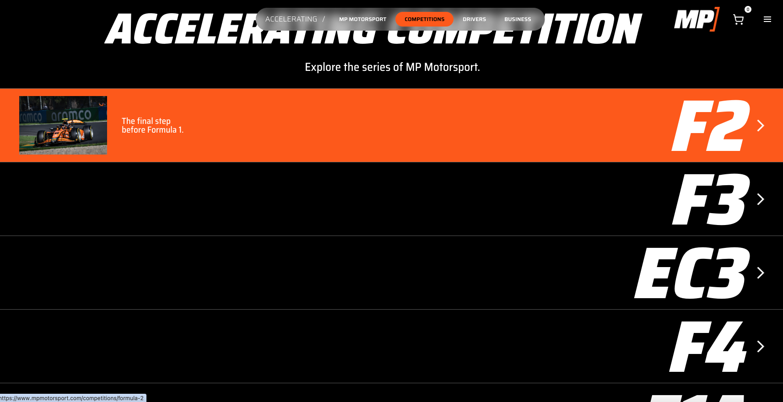
Ref
OVER ALL
CUSTOMER
Inf + track
LINK

Slide 21

Ref
OVER ALL
CUSTOMER
LINK

Slide 22
Special Point
IDEA

Slide 23
VDO
Hilight BN

Slide 24
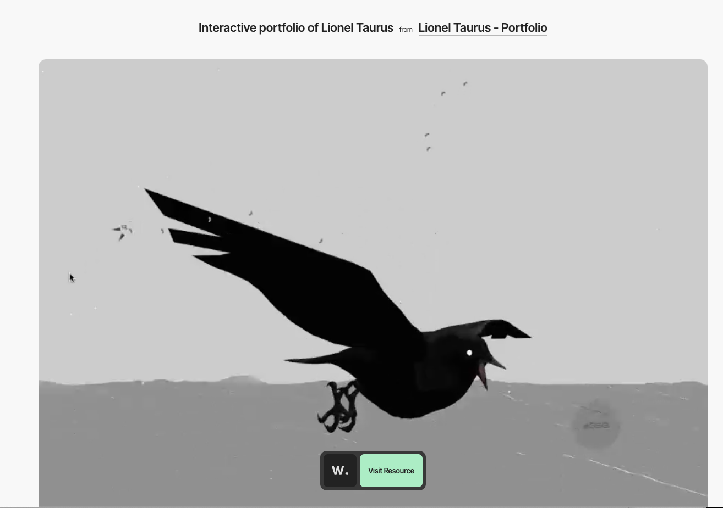
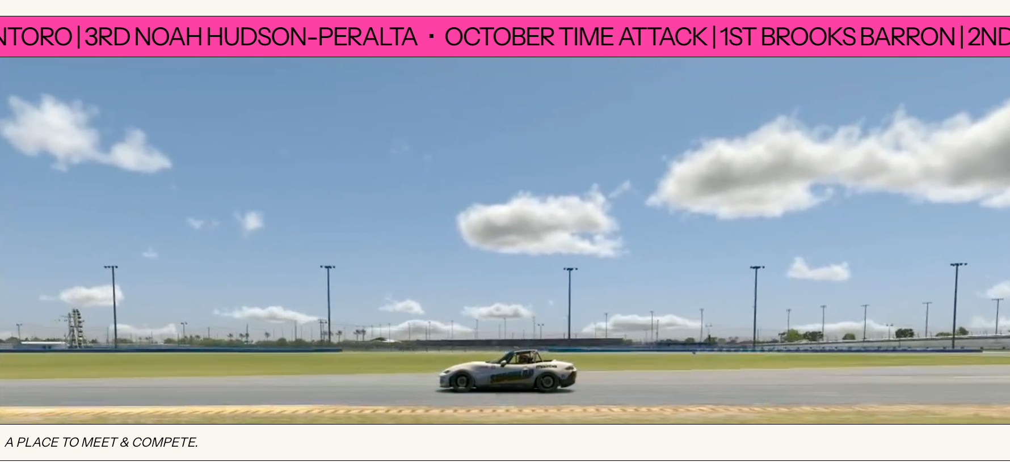

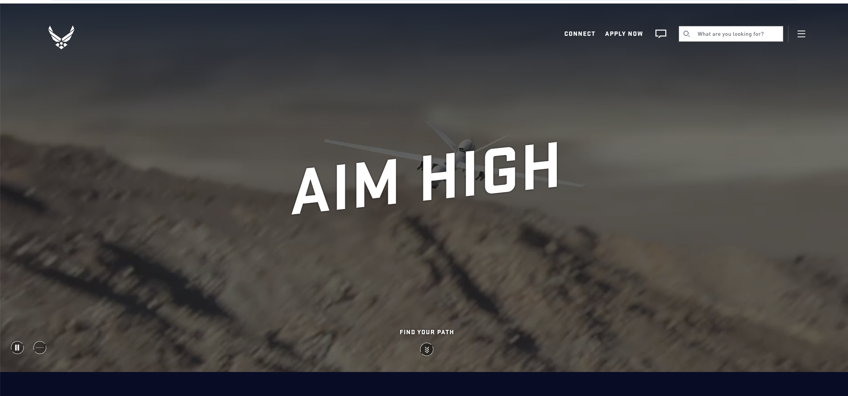
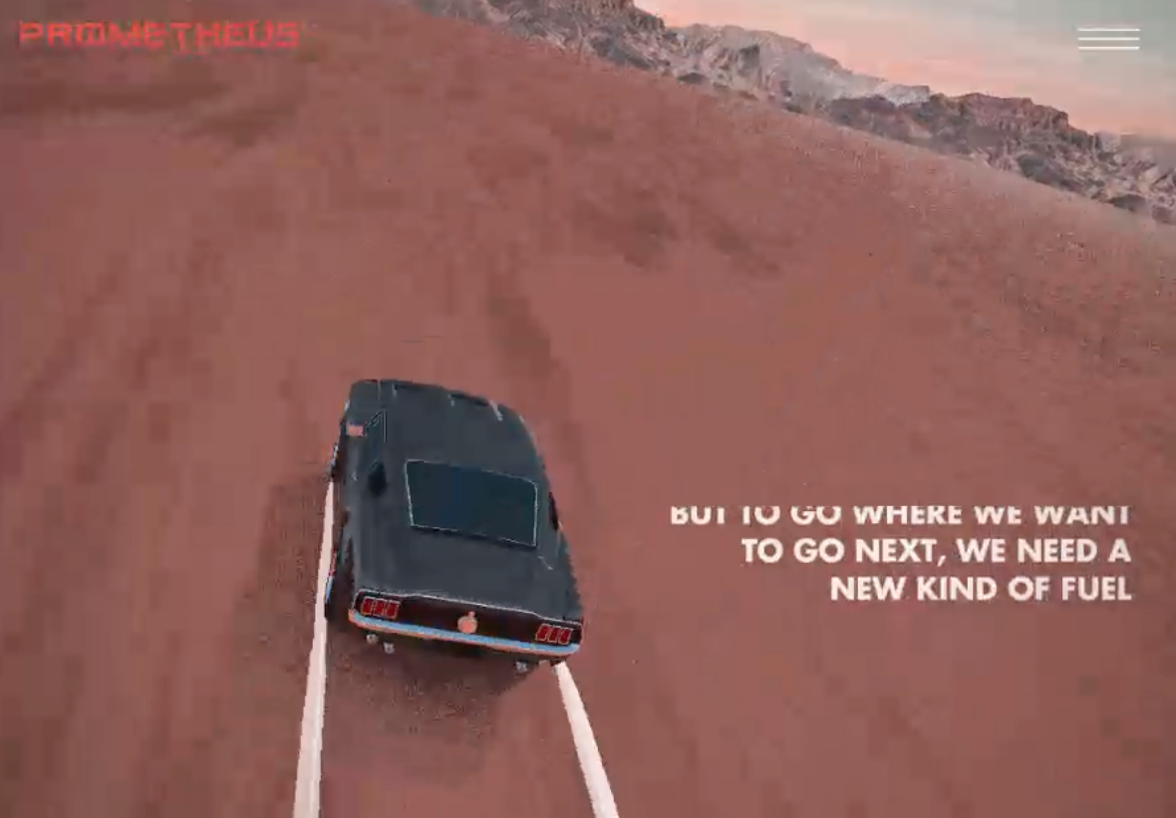
LINK
LINK
LINK
LINK
LINK

Slide 25
ref
Hilight BN

Slide 26

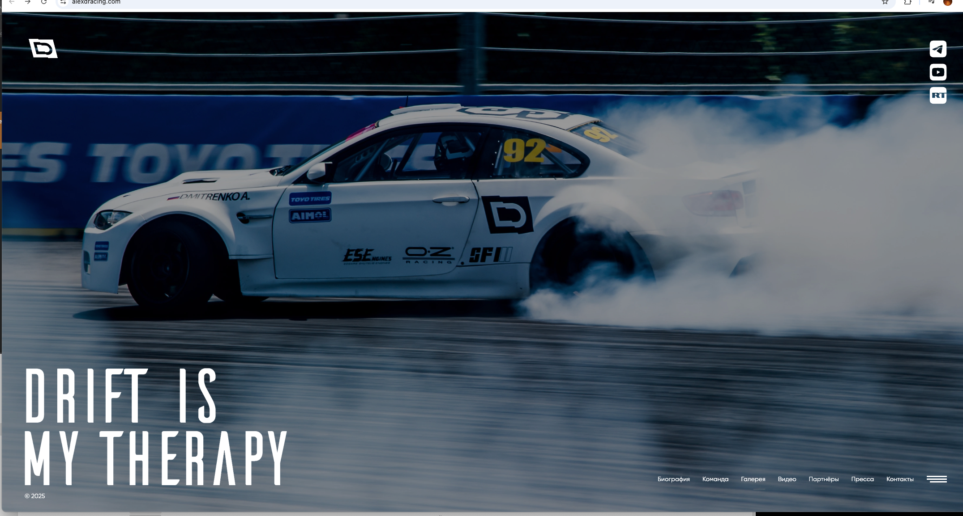
LINK
LINK

Slide 27
OTHER
Over All

Slide 28

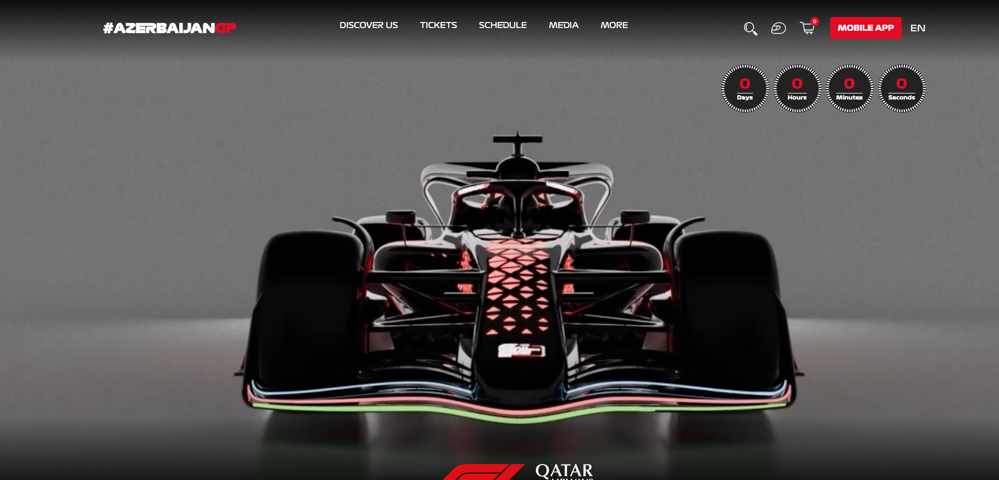
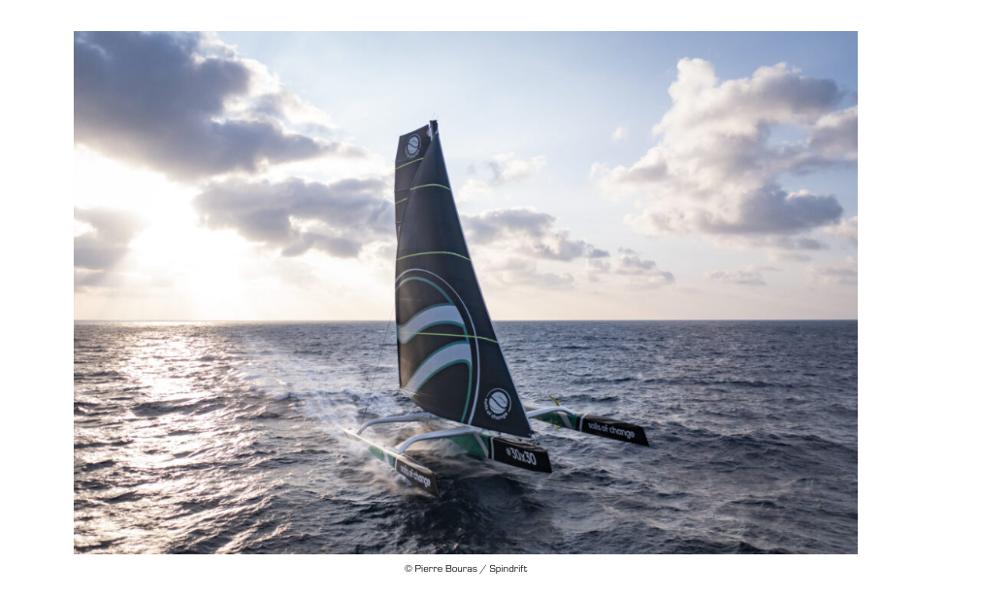
LINK
Story
LINK
Inf –FINAL RACE
https://www.sailsofchange.com/news/jules-verne-trophy-a-thursday-start-for-the-maxi-trimaran-sails-of-change/
https://sailracing.com/se/en/category/men/jackets
https://alexdracing.com/
PIC

Slide 29
THANK YOU!

